Slide 1




Nomadic Herders:
Enhancing the Resilience of Reindeer Herders’ ecosystems and livelihoods
CAFF Biennial 2013 Yakutsk
Mikhail Pogodaev, Chair of WRH

Slide 2
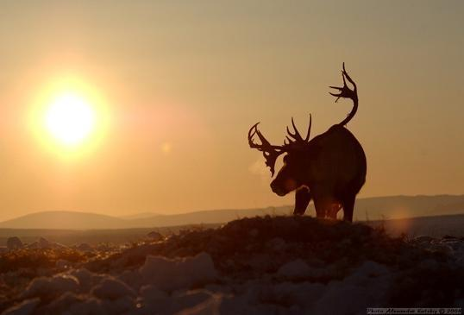
Project Objectives
Conserve and enhance biological diversity
Reduce pasture degradation
Sustain resilience of habitats
Sustain resilience of nomadic reindeer herder communities
Conserve and enhance traditional cultural values of pastures
Initiated by the Association of World Reindeer Herders in 2009
Based on methods and results of IPY EALAT
Linked to project “The Economics and Land-Use Conflicts of Sami Reindeer Herding in Finnmark: Exploring Alternatives” in Norway
Pic: A. Kutskiy, EALÁT/ ICR, Chukotka, 2008

Slide 3
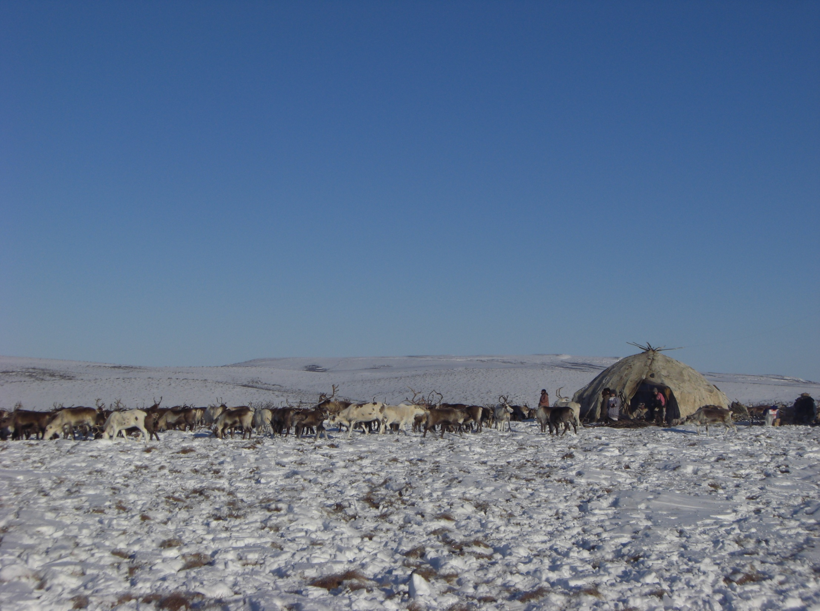
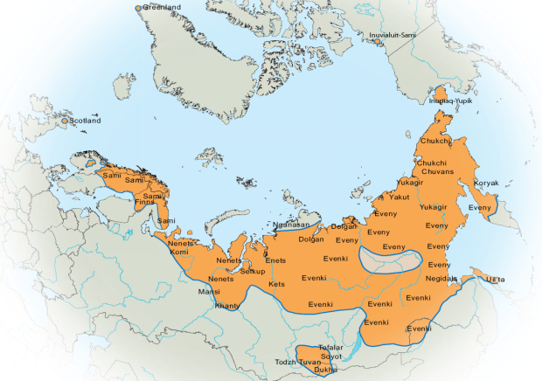
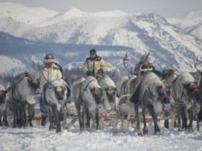
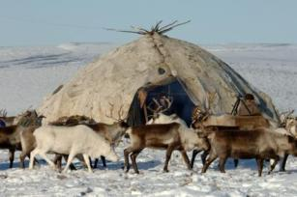

World Reindeer Husbandry
A Circumpolar Livelihood for Indigenous Peoples
E.I Turi, EALÁT, 2008
Notes:
Many ind p in the Arctic.
Focus = RH - similar challenges,
100 000
Almost all arctic states
Change:
Observe and feel climate change and socio-economic changes already.
These changes is more rapid and pronounced in the Arctic, effecting ind p societies.

Slide 4
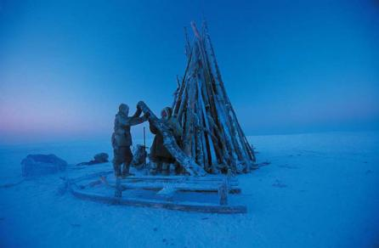
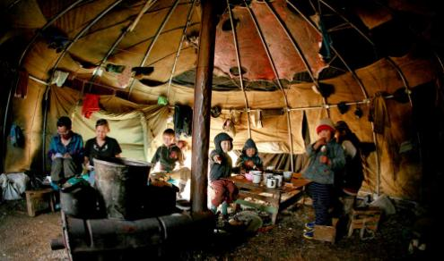
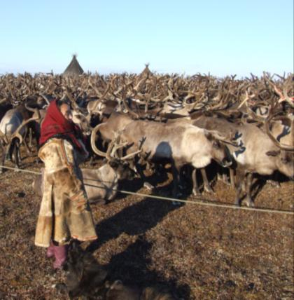
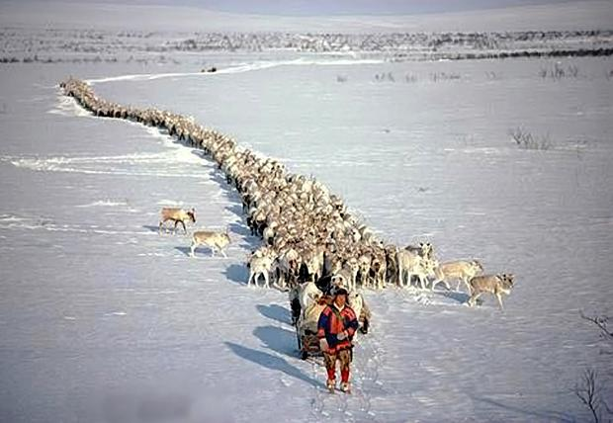
Pic: L.Monami
Pic: E. Agruboeva
Reindeer Herding as an Arctic,
Indigenous, Nomadic Livelihood
Pic: E.I Turi ICR/ EALÁT, 2007
Pic: S.D Mathiesen, ICR/ EALÁT, 2008
Pic: B. Alexander
Notes:
Nomads - living and working outdoors

Slide 5
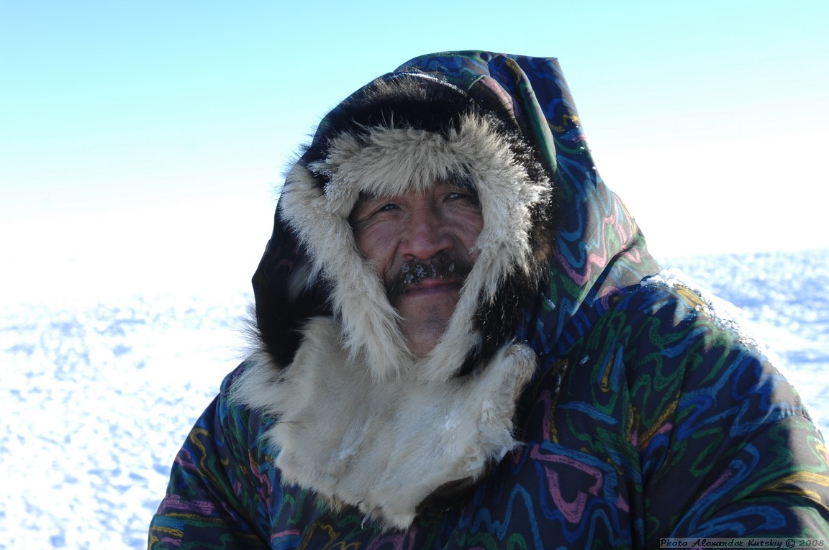

Human-coupled ecosystems and biodiversity
Senior reindeer herder Vassily Vassilievich Nomchaivyn
of brigade nr 4 in Kanchalan, Chukotka AO:
“…Remember, it is not us reindeer herders who have been the cause of climate change. The reindeer know what paths to take. Many people have lost their connection with nature, but the animals maintain this connection and that is why we follow the reindeer.”
Pic: A. Kutskiy, EALÁT/
ICR, Chukotka, 2008

Slide 6
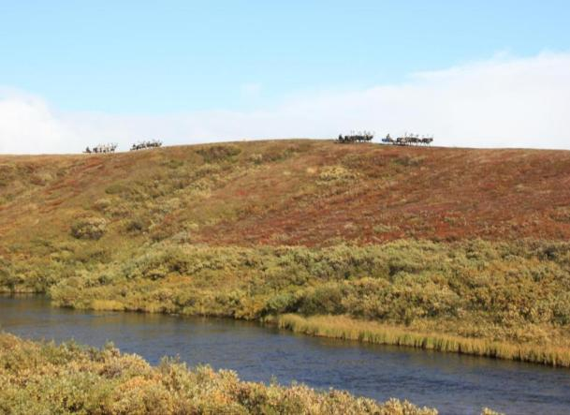
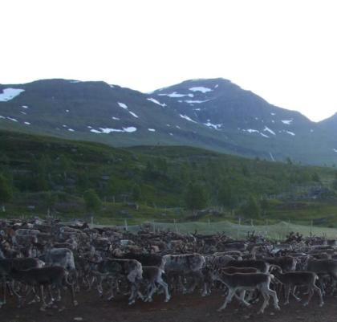

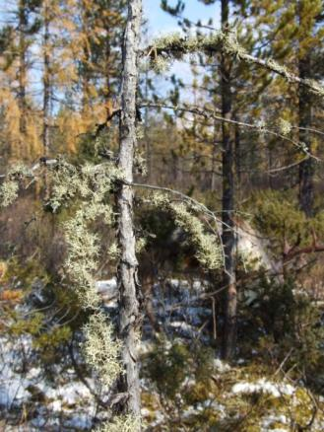

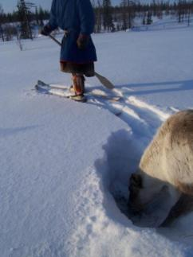
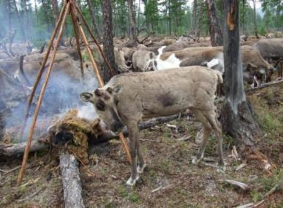

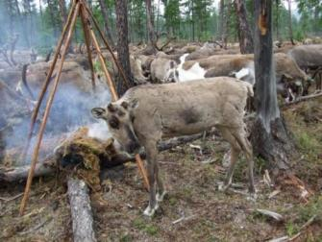
Traditional Knowledge for Enhancing Resilience to Change
Traditional Knowledge-based Protection of the Arctic and Arctic Biodiversity
xxx
Notes:
Adaptation to climate change is about the knowledge on biodiversity and protection of the grazing land

Slide 7
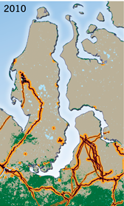
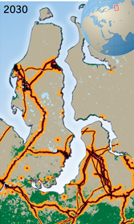
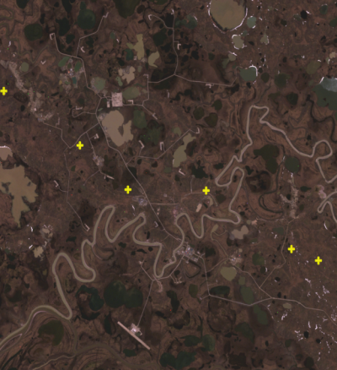
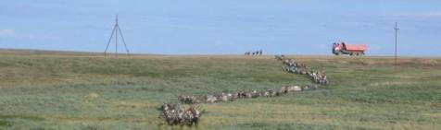
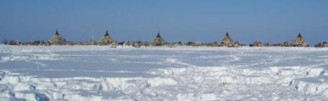
Ex: Development and Land Use Change
Yamalo-Nenets AO 2010-2030
Bovanenkova gas field, showing reindeer migration route in
2009 with yellow dots. Source: Oskal et al, 2010.
Source: Magga et al, 2011.
Pics: A.Degteva/ EALÁT, 2009 & E.I.Turi/ EALÁT, 2007

Slide 8
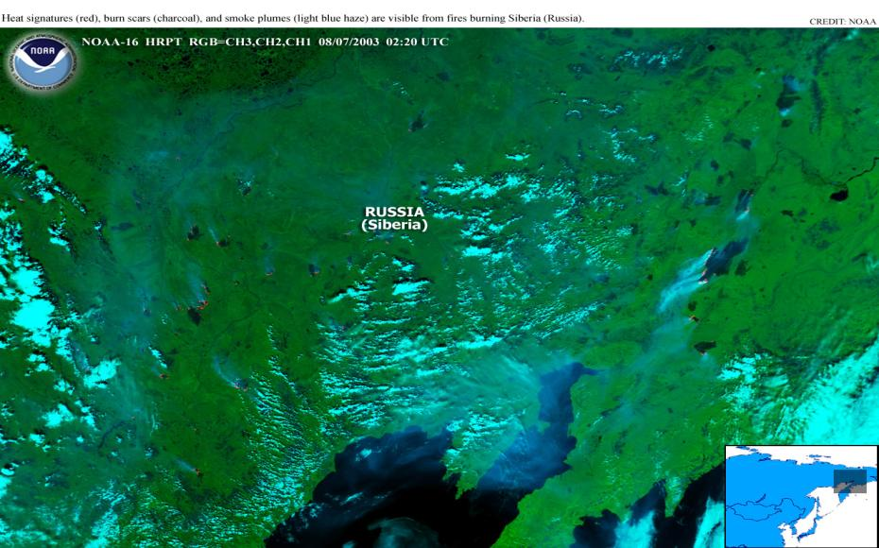
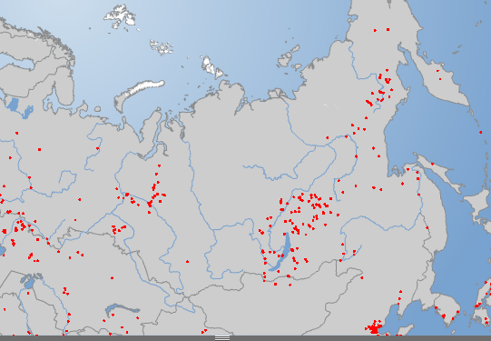


Ex: Loss of pastures and Tundra/
Taiga Fires
Fire hotspots
Imagery: NOAA/ NASA and
NASA/ Arctic Portal

Slide 9
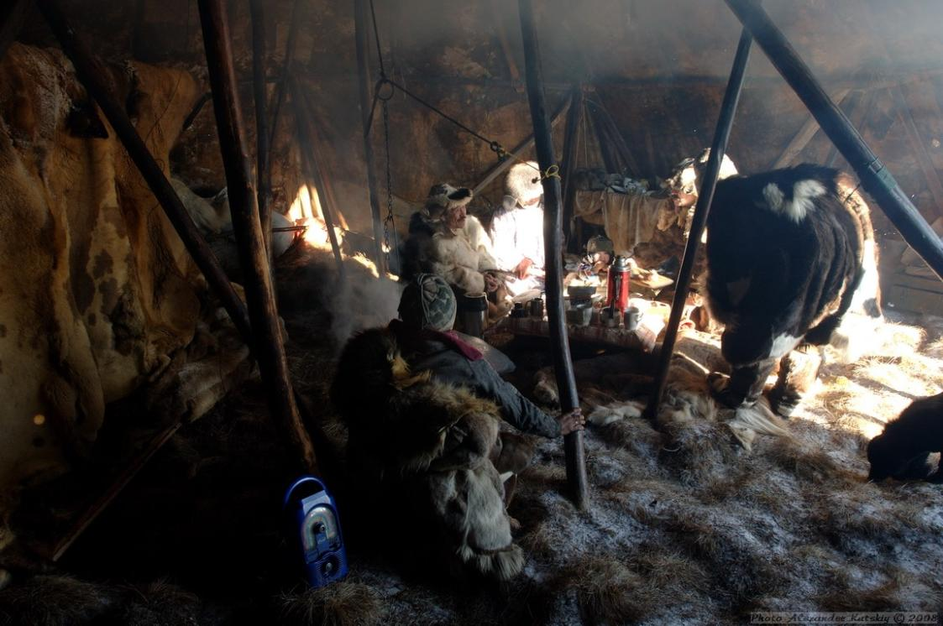
Methods and strategies
Case-based approach
Traditiional knowledge and Scientific assessments
  Climate change, land
  use change, biodiversity
Tools for monitoring of biodiversity and land degradation
Knowledge exchange, community-partnerships,
Community-based monitoring
GIS database, policy briefs
Outreach, awareness raising
Local capacity building and education
Pic: A. Kutskiy, EALÁT/ ICR, Chukotka, 2008

Slide 10
Nomadic Herders Project Design
Component 1:
Development of tools to observe and monitor change
Component 2:
Use of tools by reindeer herders, decision makers and industry
Component 3: Capacity Building. Education and Awareness Raising
Component 4: Regional Collaboration, Diseemination, Replication
Mapping past and current land uses
Monitoring status and trends of biodiversity,incl through traditional knowledge
Participatory Scenario Planning
Mobile technology application
Develop a multi-stakeholder partnership/forum for reindeer herders, govnt, industry
Develop collaborative land use plans
Monitor and evaluate plans regularly
Community-level workshops on monitoring environment change
Education and awareness raising in nomadic schools & online courses
Policy briefs
Books, films, photo exhibits
Cross-site visits
Website
Participation in international forums (UNPFII, UNEP, CBD, UNCCD)
Project Management and Monitoring

Slide 11
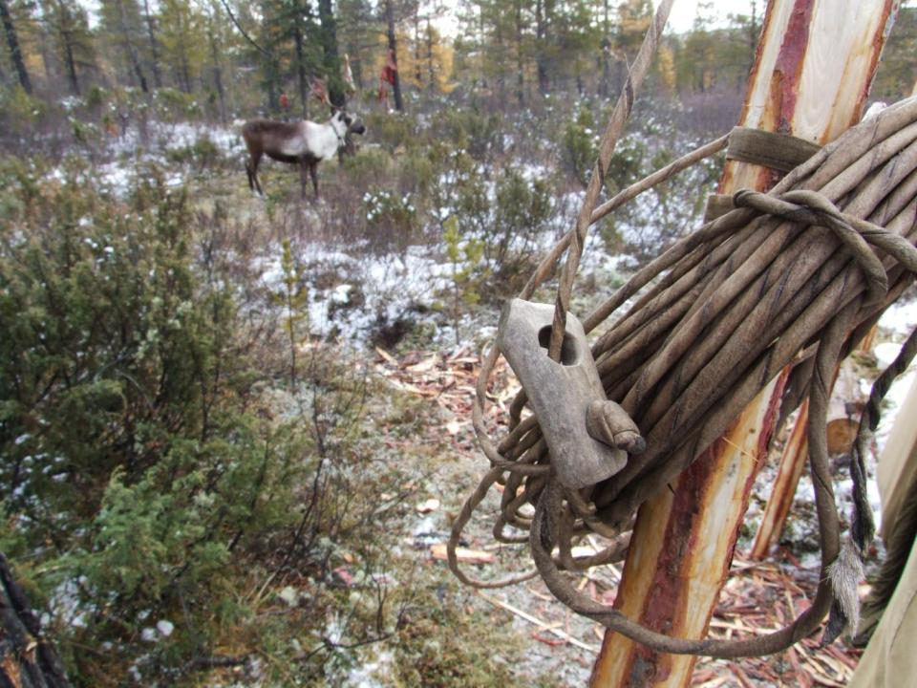
Key Partners
UNEP/GRID-Arendal, Norway
International Centre for Reindeer Husbandry (ICR)
All-Russian Research Institute for Nature Conservation
Saint-Petersburg State University
Herzen University
Association of World Reindeer Herders (WRH)
Sami Council
UArctic EALÁT Institute for Circumpolar Reindeer Husbandry at NEFU
Pic: A. Oskal, EALÁT/ ICR, Sakha Rep, 2008

Slide 12
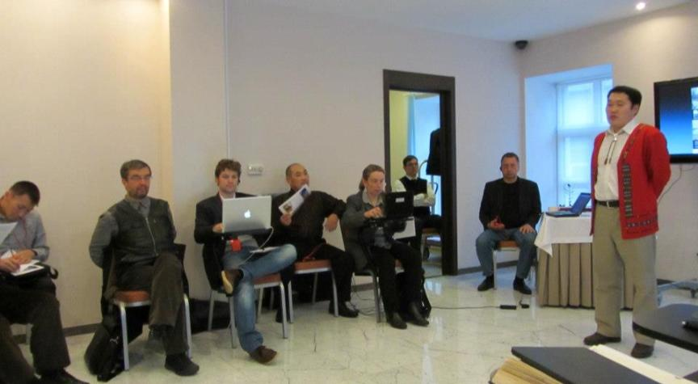
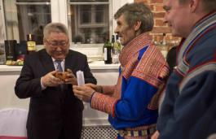
Nomadic Herders Week at the occasion of 380th Anniversary of the Commonwealth between Russia and Yakutia, 25th November – 1st December 2013, Saint-Petersburg
Johan Mathis Turi (Association of World Reindeer Herders) presents a Guksi to the President of Sakha Republic © Lawrence Hislop

Slide 13
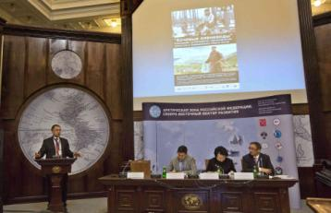
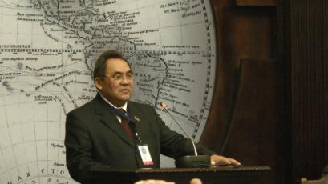
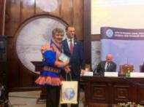
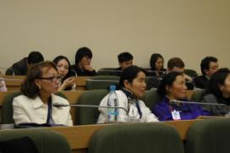
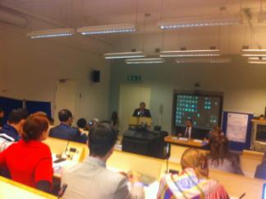

Nomadic Herders Days in St.Petersburg 27-29 Nov 2012
International Conference: Arctic Zone of the Russian Federation: North-Eastern Vector of Development
  Arranged by the Russian Geographical Society and Sakha Republic
  Co-arranged by ICR, WRH and UArctic EALÁT Institute
International Science Conference: Nomadic Herders and Industrial Development of the Arctic
  Arranged by St.Petersburg State University, ICR and UArctic EALÁT Institute, including GEF/ UNEP

Slide 14
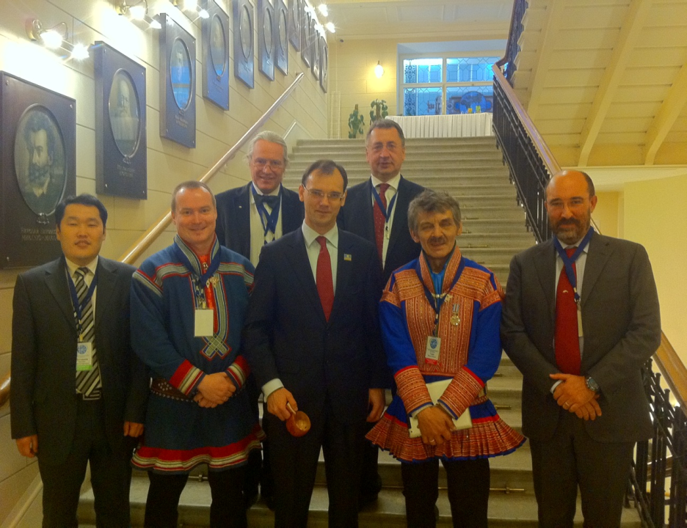
Nomadic Herders meeting with the Vice-President of Sakha Republic Dmitry Glushko at the Russian Geographical Society, 28th Nov. 2012, Saint-Petersburg

Slide 15
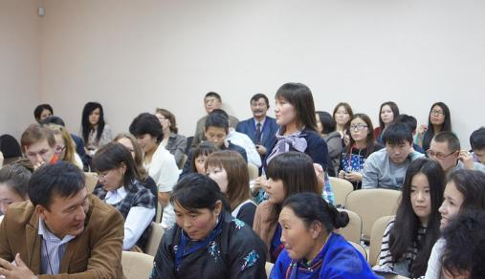
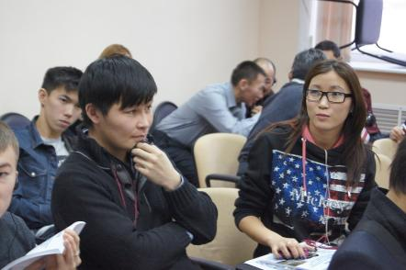
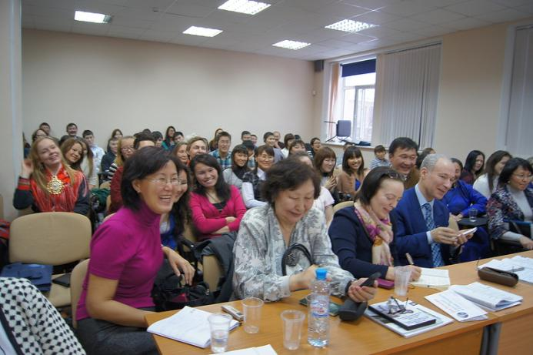

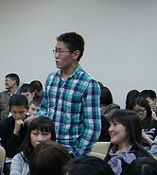




St.Petersburg, Russia
30th Nov 2012
TRAINING OF FUTURE ARCTIC LEADERS
UArctic EALÁT Institute course program, at
Institute of Indigenous Peoples of the North, Herzen University, St.Petersburg
Engaging 40 youth from reindeer herding communities across the Russian north

Slide 16
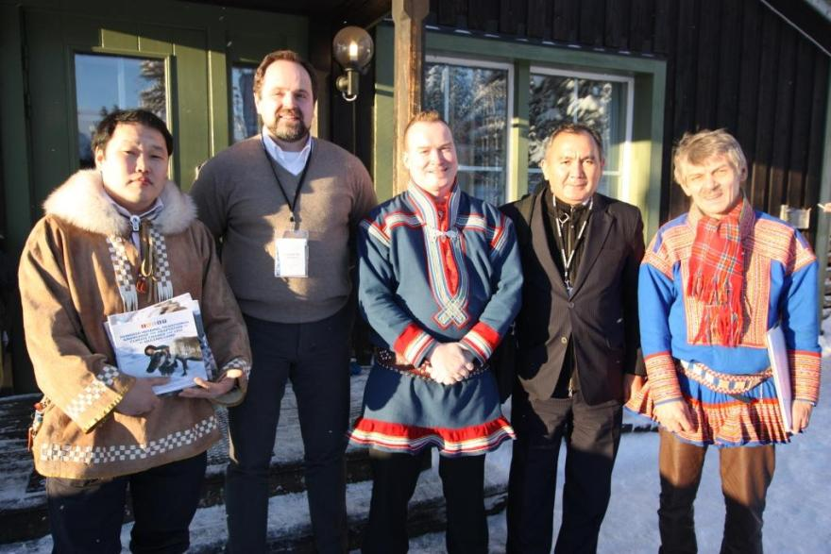
Arctic Environment Ministers Meeting
Jukkasjärvi, Sweden, 5-6 February, 2013
Russian Minister of Natural Resources and Environment Mr. Sergey Donskoy and Director of the Department of International Cooperation Mr. Nuritdin Inamov with Nomadic Herders Team

Slide 17
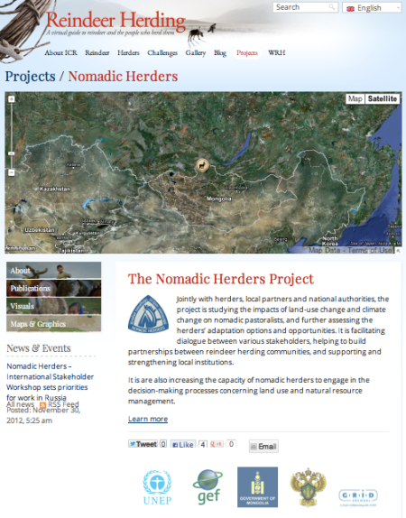
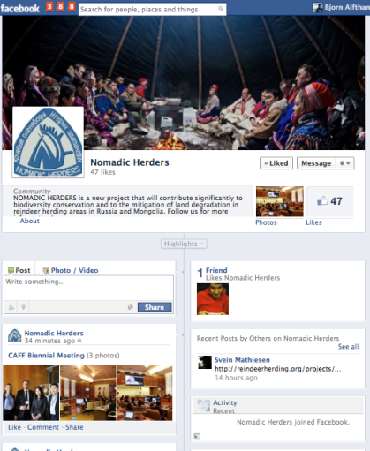
Nomadic Herders Communication: Website and Facebook page

Slide 18
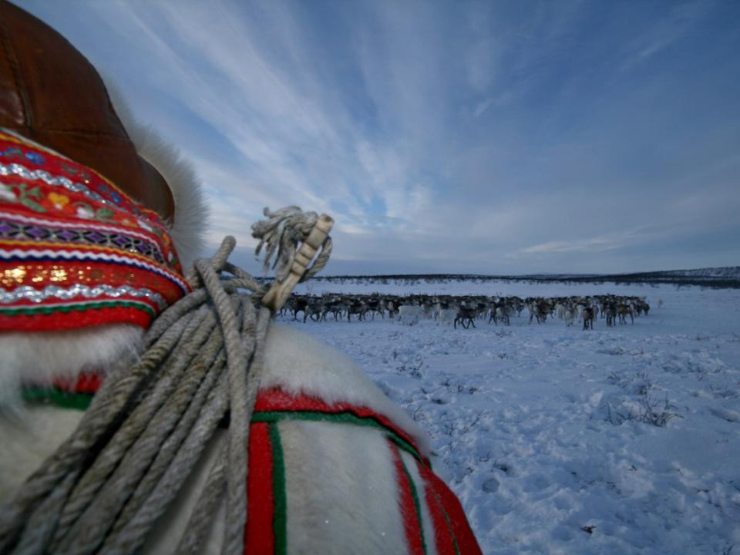

Arctic Indigenous Peoples can
Contribute to Protection of
Arctic Nature and
Biodiversity
Photo: J.M. Gaup, 2009
Notes:
Increase our Holistic Understanding of Arctic Change
Community-based Monitoring
Traditional Knowledge – of use beyond indigenous/ local societies
Protection of Pasture Lands

